Slide 1
GURU NANAK INSTITUTE OF TECHNOLOGY
DEPARTMENT OF CSE
MAJOR PROJECT PRESENTATION
TITLE
Memory Game with Score Board and Authentication using AngularJS and Firebase
PROJECT GUIDE:
Dr. S. Jayanthi
Professor
TEAM MEMBERS:
A. Manasa (15831A0503)
C. Sahithi Priya (15831A0529)
G. Poojith Varma (15831A0554)

Slide 2
CONTENTS:
Abstract
Testing
Introduction
Implementation
Literature Survey
Future Enhancement
Existing and Proposed System
Conclusion
System Architecture
References
System Requirements
System Design
Coding

Slide 3
ABSTRACT:
In this project, we can check the player have a perfect memory, the memory game can be seen as a game of strategy. In this application, the player has to match each square by logo. Click the squares to flip them. Score multipliers are applied if one or both of your matching squares were viewed for the first time.

Slide 4
INTRODUCTION:
The main scope of this game is the guessing game which is used by color tiles. We can Match each square by color. we can click the squares to flip them. Score multipliers are applied if one or both of your matching squares were viewed for the first time.

Slide 5
LITERATURE SURVEY:
Title: “MindTactics”
Author: Kenneth oum, Hasan Ayaz
Year: 2010
Description: The purpose of this project is to develop compelling BCI game design methods. MindTactics is capable of integrating data from multiple devices including the optical brain imaging based BCI developed at Drexel University, and it records behavioral log files for further analysis.

Slide 6
LITERATURE SURVEY:
Title: “Evaluate children learning experience of multitouch flash memory game”
Author: Lau Siong Hoe
Year: 2014
Description: Flash [::memory::] [::game::] based on multitouch technology is designed with richness of artistic effects which enhances children learning experience. It offers an opportunity for children to learn more effectively in a fun and enjoyable environment which improve their thinking, memorization and social skills.

Slide 7
LITERATURE SURVEY:
Title: “Visuospatial working memory game and measured memory performances at various ages”
Author: Takahiro Miura
Year: 2016
Description: Because of rapid population aging, it is necessary to design and develop senior-friendly or disability-friendly interfaces that can decrease the cognitive workload caused by an interface. At that time, the design implications and evaluation criteria of an interface should be needed for creating senior-friendly and disability-friendly interfaces. One of the elements that relate to memory functions for manipulating interfaces include working memory.

Slide 8
EXISTING SYSTEM:
In the existing system, the interface of the applications is not user-friendly and responsive. The user interface is much complex when compared to UX and UI.
Making integration with the cloud makes the server side complex when compared to having a local server.
In the existing system it is much harder to set up integration with API like Cloud API, Google API but with firebase and angular connecting to external API makes it much simpler.
In existing system are time-consuming and it is much harder to control multiple data information coming from the database.
It has a more complex code and difficult to understand by the developer.
In the Existing system it’s very difficult to create Mobile Application like android, IOS , blackberry or any.
In the Existing system, it's very difficult to create Desktop Applications like Windows 32- Bit /64- Bit, IOS or any.

Slide 9
PROPOSED SYSTEM:
It has cloud Integration, which makes application server less and makes the application to render fast.
Database integration with cloud and it includes offline support and makes it ready for the desktop, mobile, and web ready.
Using Google Authentication & Authorization The user can Login with Google Login/Signup, Guest Login/Signup, Direct Login/Signup.
It can also integrate with Facebook, GitHub, and other online services easily.
In this application, we can create Android Application, Desktop Application, IOS Applications, Windows Applications by adding Interfaces, API’s, in a much-simplified pattern.
The developer can code complex applications with much easier code readability compared to existing web frameworks.
Using angular application, we can reduce the files sizes by 18% - 45% compared to Java, PHP, and Ajax.

Slide 10
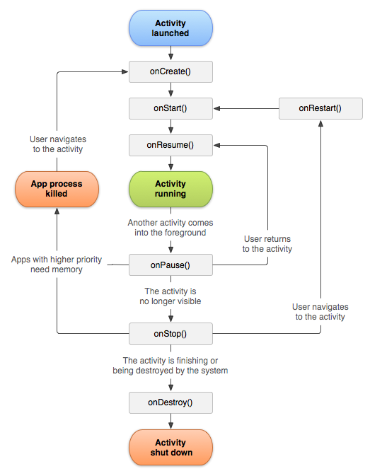
SYSTEM ARCHITECTURE:
Figure. Data flow diagram

Slide 11
SYSTEM REQUIREMENTS:
Hardware Requirement:-
Operating System – Windows
Processor – 2 GHZ or Higher
Ram – 4 GB
Hard Disk – 20 GB
Software Requirement:-
Technologies Used – Libraries of Npm and amp, Angular Cli, Yarn, AuthGaurd, Angular material, rxjs, HttpClientModule, External API’s, Chocolatey, Cordova, Cordova-android, Electron js.
Language – Html, Css, AngularJs, Jquery, Libraries of Npm & amp, Ng , MaterialJs
Software – NPM, Angular CLI , Firebase, GitHub, Android Studio ,Java 1.8.0+ SDK .
Tool –Visual Studio Code
Database – Firestore using Firebase Cloud

Slide 12

SYSTEM DESIGN:
Login
Register
start
Accomplishments
Profile
Figure. Use Case Diagram

Slide 13
CODING:
game.component.html:
<div class="jumbotron">
<h1 class="text-center">Memory Game</h1><br><br>
<img src="../favicon.ico" alt="logo" class="img-responsive center-block img-thumbnail" /><br><br>
<!-- ACCOMPLISHMENTS SECTION -->
<label class="text-info" for="list-accomplishments">Accomplishments:</label>
<p class="text-warning" *ngIf="players.length === 0">there is no accomplishments yet!</p>
<ul class="list-group" style="width: 290px;" id="list-accomplishments">
<li class="list-group-item" *ngFor="let player of players | sortPlayers">
{{player.name}}, finished at -
<span class="text-warning">{{player.minutes | countPipe}}:{{player.seconds | countPipe}}</span>
, on - <span class="text-danger">{{player.size === 4 ? '4x4' : '6x6'}}</span>.</li>
</ul>
<ul>
<button class="common-btn btn" routerLink='/board'>board</button></ul>
</div>

Slide 14
game.module.ts:
import { NgModule } from '@angular/core';
import { CommonModule } from '@angular/common';
//import { GameComponent } from './game.component';
@NgModule({
imports: [
CommonModule,
],
declarations: [
]
})
export class GameModule { }

Slide 15
TESTING:
CASE 1
TITLE: User Login.
DESCRIPTION: User login is which enables registered user to login into the application.
ASSUMPTION: It is assumed user can login if his account exists else can register to the application.
STEPS; 1. User can get access to application by running the web page
2. User can login into his account by entering username and password else can register to the application.
EXPECTED OUTPUT: User will login into his account else can register to the application.

Slide 16
CASE 2
TITLE: Registration page.
DESCRIPTION: It is used for new users to register themselves into application.
ASSUMPTION: It is assumed that any new user can register by providing their details.
STEPS: 1.User can register by going through user login
2. New user has to provide valid details in order to register into the application.
EXPECTED OUTPUT: A new user can register into the application successfully.

Slide 17
CASE 3
TITLE: Start and Play.
DESCRIPTION: This Module helps the user to Start and Play the game.
ASSUMPTION: It is assumed that user can Start and Play the game.
STEPS: This page can be accessed after user logging in, user can Start and Play the game.
EXPECTED OUTPUT: Every user can Start and Play the game.

Slide 18
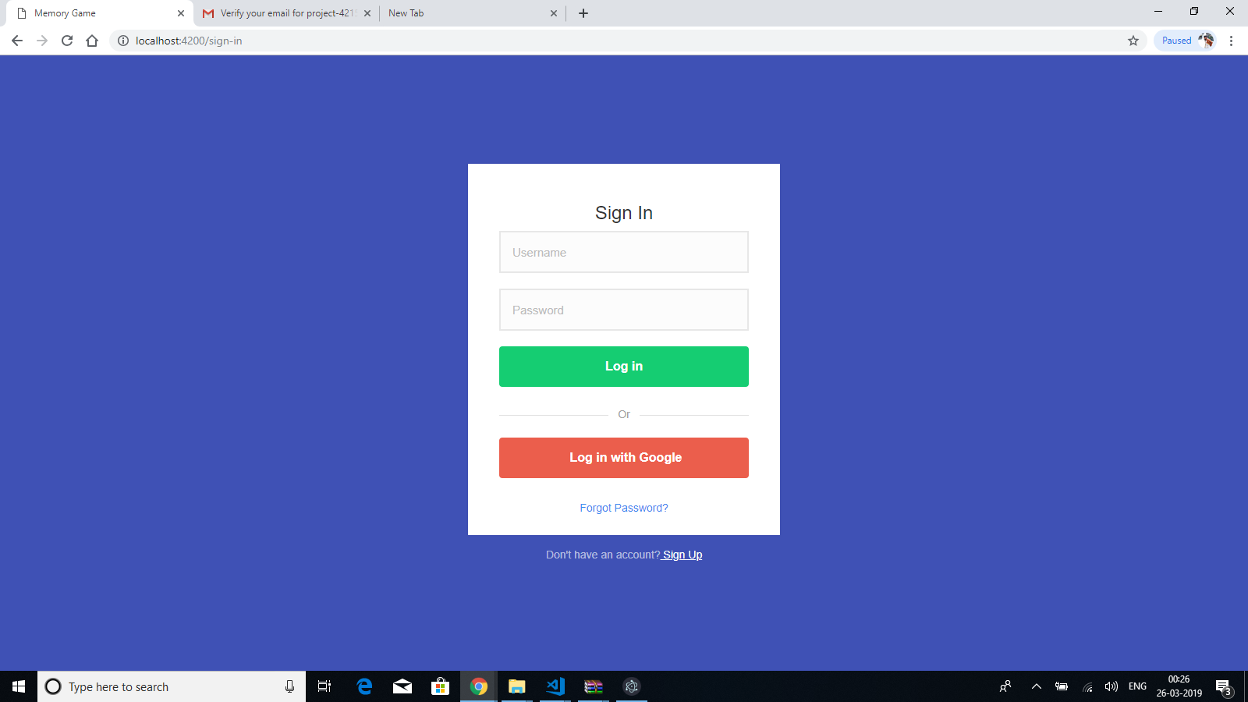
IMPLIMENTATION:
LOGIN PAGE

Slide 19
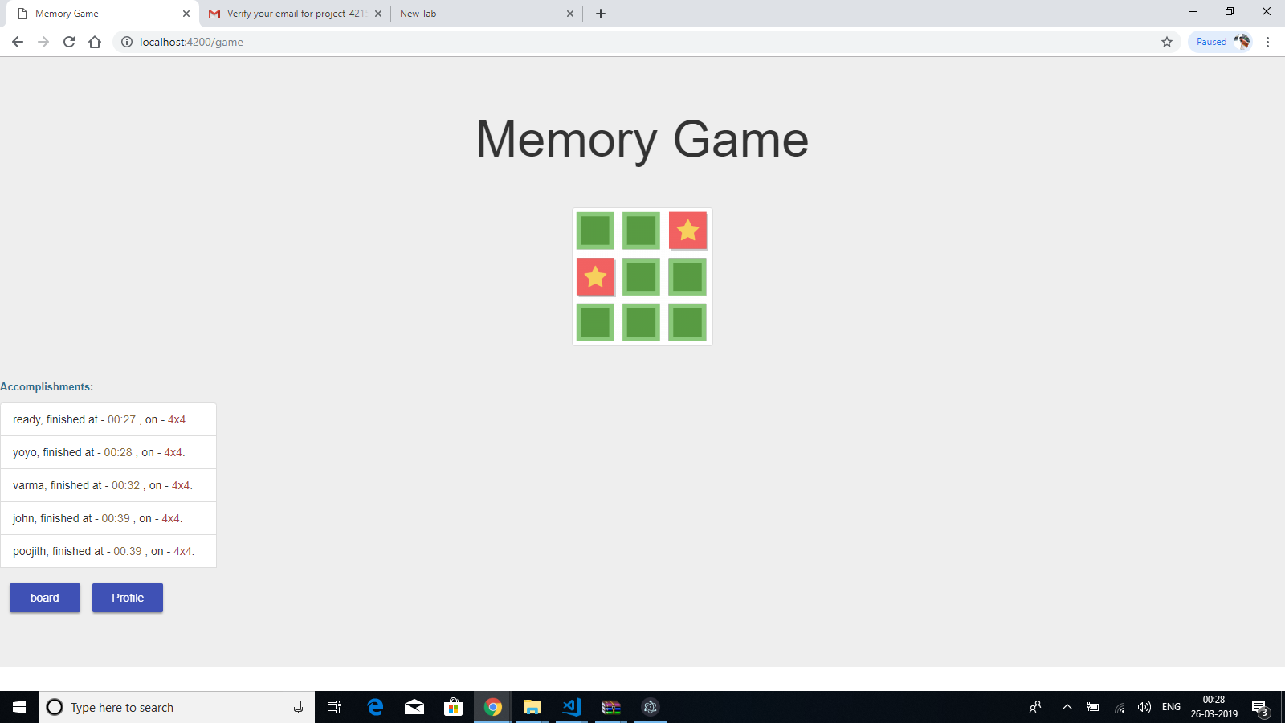
WELCOME PAGE

Slide 20

REGISTRATION PAGE

Slide 21
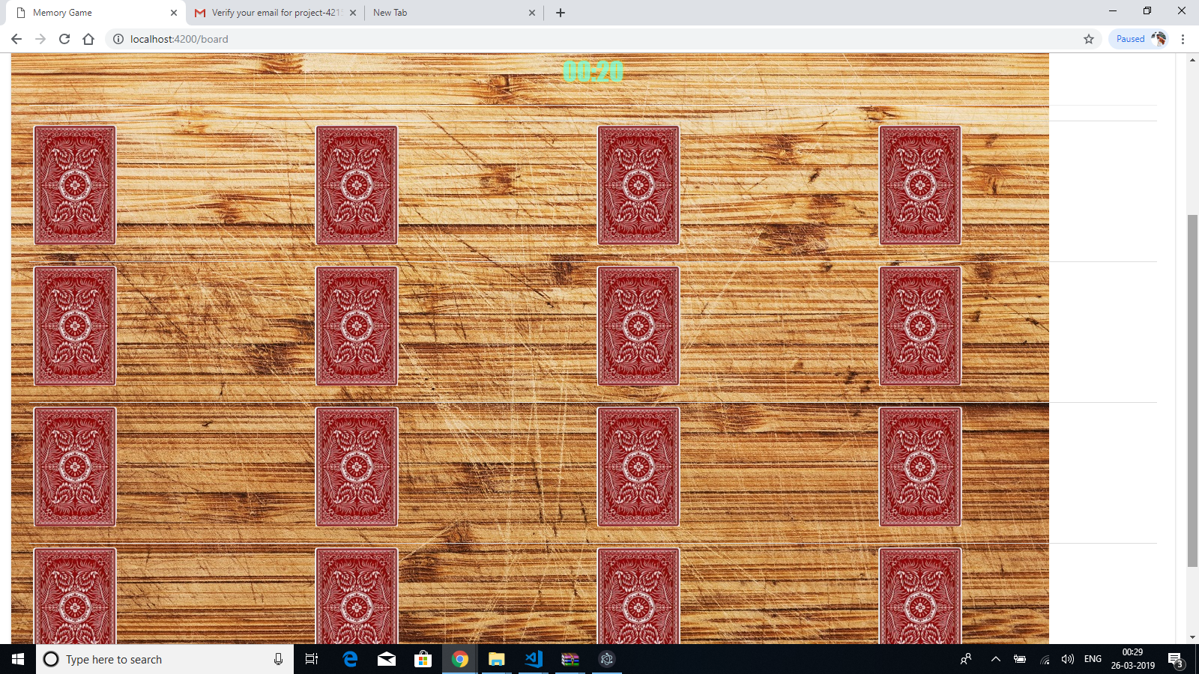
USER ACTIVITIES PAGE

Slide 22
FUTURE ENHANCEMENT:
We have used few technologies in our project, among them Angular and Node is very important as our final application should run on this platform. Using these technologies a project can be developed on different platforms like web, desktop and mobile app. Our application will be successfully built on this as we were able to use many built-in features of Angular.

Slide 23
CONCLUSION:
The Developed web page shows how is the working functionality of guessing game. The conclusion is to develop a game of memory. Match each square by logo! we can click the squares to flip them. Score multipliers are applied if one or both of your matching squares were viewed for the first time.

Slide 24
REFERENCES:
MindTactics: A Brain Computer Interface gaming platform
Kenneth Oum ; Hasan Ayaz ; Patricia A. Shewokis ; Paul Diefenbach
2010 2nd International IEEE Consumer Electronics Society's Games Innovations Conference
Evaluate children learning experience of multitouch flash memory game,
Liew Tze Hui ; Lau Siong Hoe ; Hishamuddin Ismail ; Neo Han Foon ; Goh Kah Ong Michael
2014 4th World Congress on Information and Communication Technologies (WICT 2014)
Visuospatial working memory game and measured memory performances at various ages
Takahiro Miura ; Ken-ichiro Yabu ; Kenichi Tanaka ; Kazutaka Ueda ; Tohru Ifukube
2016 IEEE International Conference on Systems, Man, and Cybernetics (SMC)

Slide 25
THANK YOU

